Slide 1



Presentation X
Monte Carlo Method
Thu Ta Zaw
2415121095

Slide 2

Monte Carlo Simulation
What is Monte Carlo Simulation
Monte Carlo simulation is a computational method that uses random sampling, models complex systems probabilistically and estimates quantities that are analytically intractable.
Uses the law of large number to average the samples which can find the true expectation values along with the central limit theorem to reduce the statistical error.
It is used when:
When the system is high-dimensional
Governing equations are nonlinear.
Boundary conditions are complex
Experiments are too expensive.

Slide 3
Monte Carlo Simulation
Strength of Monte Carlo Simulation
Handle complex geometry
No need for analytical solutions
Flexible and general
Reveals hidden variables
Easily extensible
Limitations of Monte Carlo Simulation
Computationally expensive
Statistical noise
Depends on model accuracy

Slide 4
Monte Carlo Simulation
Tallying Monte Carlo Results
The results from the Monte Carlo are:
Distributions
Mean values
Variances
Confidence intervales
Typical outputs includes:
Histograms
Expectation values
Error estimates

Slide 5
Monte Carlo Simulation
General Monte Carlo workflow
Define the Model
Express system as probability distributions
Generate random samples
Simulate events
Accumulate statistics
Defining the Model
How accurate must results be?
What physics must be included?
How accurate must results be?
What are the outputs?

Slide 6

Monte Carlo Simulation
Probability Density Functions (PDFs)
Is non-negative
Integrates to 1
Describes likelihood of outcomes
Uniform Distributions[R,S]
This is the foundation of Monte Carlo simulations.
PDF
$$f\left(x\right)=\frac{1}{S−R}$$
CDF
$$F\left(x\right)=\frac{x−R}{S−R}$$

Slide 7

Monte Carlo Simulation
Random Number Generator (RNGs)
Computers generate pseudo-random numbers: which are reproducible and statistically random.
Linear Congruential Generator (LCG) and Mersenne Twister are common RNGs that we used in Monte Carlo Simulations
Uniform random numbers is really important as it allows Poisson distributions and sample exponential.
Exponential Distribution
Exponential Distribution is mainly used for photon step length and time between random events.
PDF
$$f\left(x\right)=\text{λ}e^{−\text{λ}\text{x}}$$
CDF
$$F\left(x\right)=1−e^{−\text{λ}\text{x}}$$

Slide 8
Monte Carlo Simulation
Inversion Method
This method sample from exponential distribution using uniform random numbers.
This method is exact, fast and is widely used.
Acceptance and Rejection Method
Commonly used when CDF cannot be inverted analytically.
This method is exact but slower when compares to the other.
This sampling method is typically use in Normal (Gaussian) Distribution.

Slide 9
Literature Review
A Monte Carlo estimation of tissue optical properties for use in laser dosimetry
The primary objective of this paper is to determine microscopic optical properties of biological tissue from measurable macroscopic quantities.
The paper provides a practical way to “invert” measurements like reflectance and transmittance into absorption and scattering parameters.
The reasons for using the Monte Carlo Simulation.
Light transport in tissue is highly scattering.
Analytical solutions are limited or inaccurate.
Monte Carlo simulates individual photon paths statistically.

Slide 10
Literature Review
A Monte Carlo estimation of tissue optical properties for use in laser dosimetry
Simulation setup
Tissue modeled as a 1 cm thick slab
Collimated beam, 1 cm diameter
Normal incidence
Photon events;
Scattering (Heney-Greenstein phase function)
Absorption
Reflection/refraction (Snell + Fresnel laws)
Result obtained has high statistical accuracy (>99%).

Slide 11

Literature Review
A Monte Carlo estimation of tissue optical properties for use in laser dosimetry
The Functional relationship of the Monte Carlo:
Diffuse transmittance:
$$T=\frac{T_{1}}{{(μ_{s}^{′}+T_{2})}^{T_{3}}}$$
Total reflectance:
$R=$ $T_{1}+T_{1}{μ_{s}^{′}}^{T_{3}}$
These equations are empirical fits to Monte Carlo data, with coefficient depending on $μ_{a}$.

Slide 12
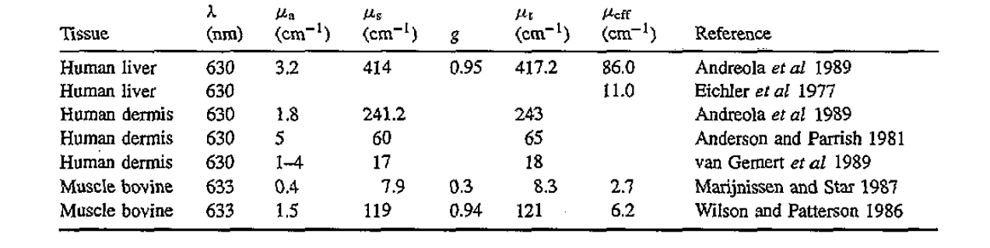
Literature Review
A Monte Carlo estimation of tissue optical properties for use in laser dosimetry
Used the following table to validate the measured tissue optical properties.
Fig. Measured Tissue optical properties

Slide 13
The End
THANK YOU FOR LISTENING
Thu Ta Zaw
2415121095

